Slide 1
Trees
LAB 12

Slide 2
TREE
A tree is a hierarchical data structure in which data is stored in terms of hierarchy. A tree data structure can be defined as a collection of nodes linked together to simulate a hierarchy. Tree is a non-linear data structure

Slide 3
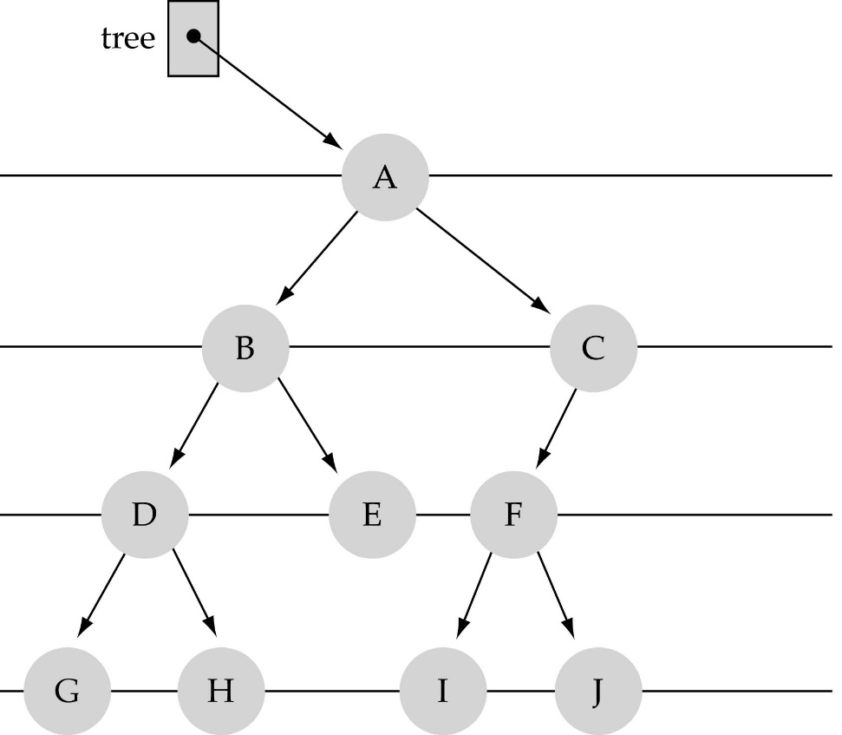
What is a binary tree?
Property 1: each node can have up to two successor nodes.

Slide 4
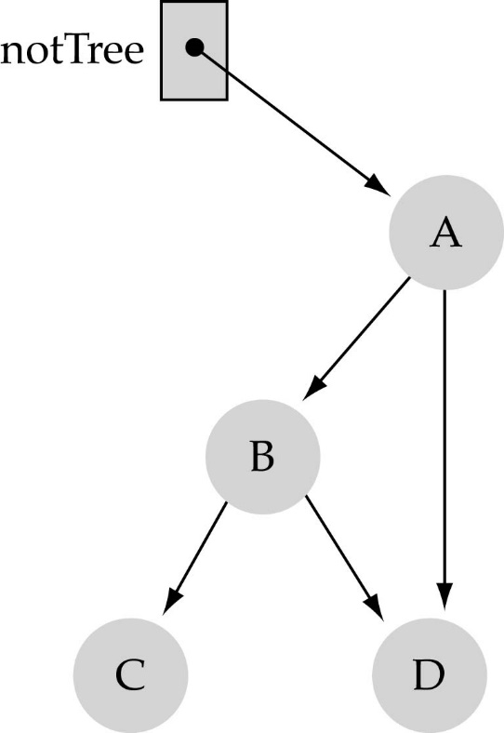
What is a binary tree? (cont.)
Property 2: a unique path exists from the root to every other node
Not a valid binary tree!

Slide 5
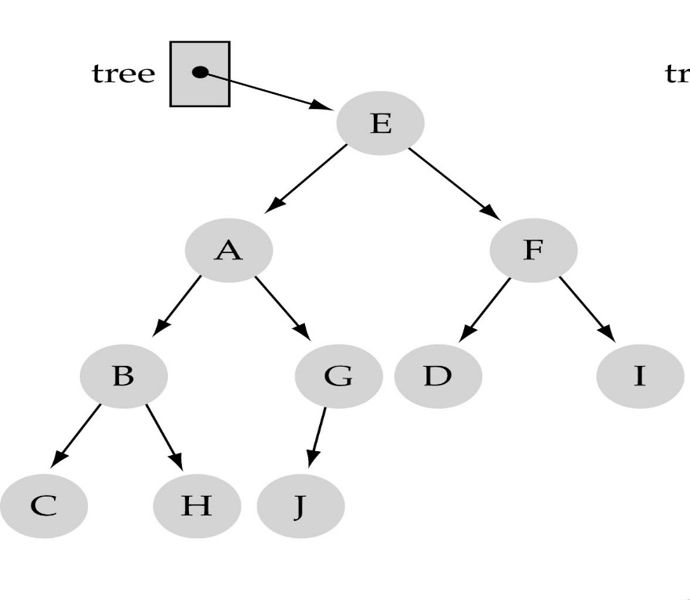
Some terminology
The successor nodes of a node are called its children
The predecessor node of a node is called its parent
The "beginning" node is called the root (has no parent)
A node without children is called a leaf

Slide 6
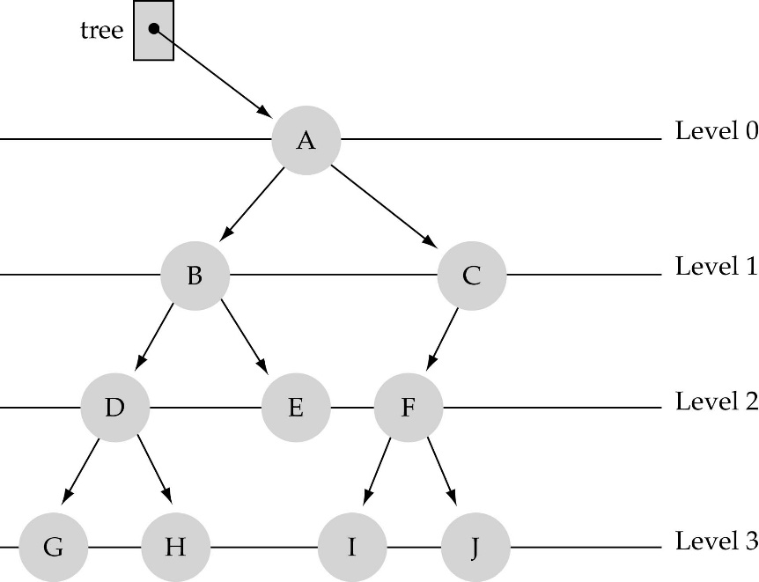
Some terminology (cont’d)
Nodes are organize in levels (indexed from 0).
Level (or depth) of a node: number of edges in the path from the root to that node.
Height of a tree h: #levels = L
(Warning: some books define h
as #levels-1).
Full tree: every node has exactly
two children and all the
leaves are on the same level.
not full!

Slide 7
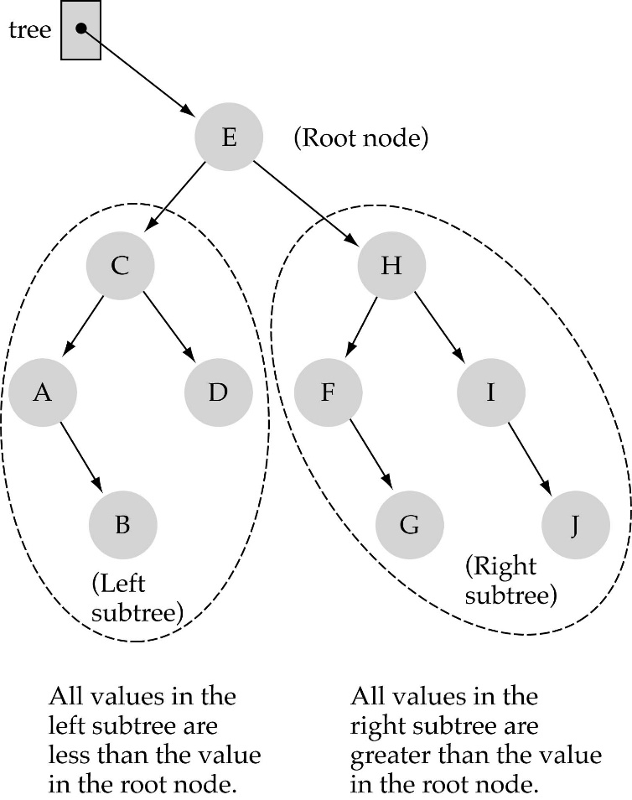
Binary Search Trees (BSTs)
Binary Search Tree Property:
The value stored at
a node is greater than
the value stored at its
left child and less than
the value stored at its
right child

Slide 8

Binary Search Trees (BSTs)
Where is the smallest element?
Ans: leftmost element
Where is the largest element?
Ans: rightmost element

Slide 9

How to search a binary search tree?
(1) Start at the root
(2) Compare the value of the item you are searching for with the value stored at the root
(3) If the values are equal, then item found; otherwise, if it is a leaf node, then not found

Slide 10
How to search a binary search tree?
(4) If it is less than the value stored at the root, then search the left subtree
(5) If it is greater than the value stored at the root, then search the right subtree
(6) Repeat steps 2-6 for the root of the subtree chosen in the previous step 4 or 5

Slide 11
Tree Traversals
There are mainly three ways to traverse a tree:
Inorder Traversal (Left, Root, Right)
Postorder Traversal (Left, Right, Root)
Preorder Traversal (Root, Left, Right)

Slide 12
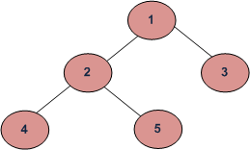
EXAMPLE
Depth First Traversals:
(a) Inorder (Left, Root, Right) : 4 2 5 1 3
(b) Preorder (Root, Left, Right) : 1 2 4 5 3
(c) Postorder (Left, Right, Root) : 4 5 2 3 1
Breadth First or Level Order Traversal : 1 2 3 4 5

Slide 13
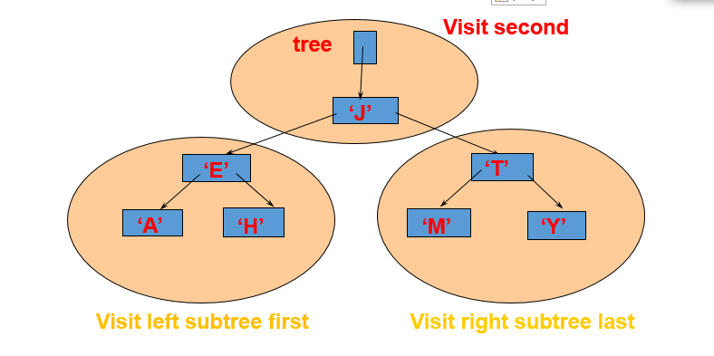
Depth First Traversals:
(a) Inorder (Left, Root, Right) : 4 2 5 1 3
(b) Preorder (Root, Left, Right) : 1 2 4 5 3
(c) Postorder (Left, Right, Root) : 4 5 2 3 1

Slide 14
In order Traversal : A E H J M T Y
Visit second
tree
‘J’
‘E’
‘T’
‘A’
‘H’
‘M’
‘Y’
Visit left subtree first
Visit right subtree last

Slide 15
Preorder Traversal: J E A H T M Y
Visit first
tree
‘J’
‘E’
‘T’
‘A’
‘H’
‘M’
‘Y’
Visit left subtree second
Visit right subtree last

Slide 16
Postorder Traversal: A H E M Y T J
Visit last
tree
‘J’
‘E’
‘T’
‘A’
‘H’
‘M’
‘Y’
Visit left subtree first
Visit right subtree second

Slide 17
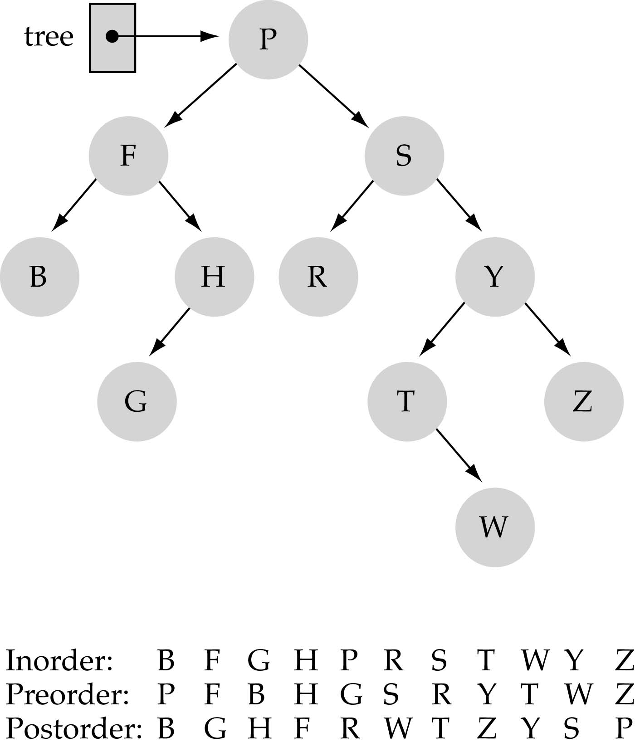
Tree Traversals: another example

Slide 18
EXAMPLE CODE :
#include<iostream>
using namespace std;
struct Node {
char data;
struct Node *left;
struct Node *right;
};

Slide 19
Insert node
Node* Insert(Node *root, char data)
{
if (root == NULL) {
root = new Node();
root->data = data;
root->left = root->right = NULL;}
else if (data <= root->data)
root->left = Insert(root->left, data);
else
root->right = Insert(root->right, data);
return root;}

Slide 20
Preorder
void Preorder(struct Node *root)
{
if (root == NULL) return;
cout<<root->data<<" ";
Preorder(root->left);
Preorder(root->right);
}

Slide 21
inorder
void Inorder(Node *root)
{
if (root == NULL) return;
Inorder(root->left);
cout<<root->data<<" ";
Inorder(root->right);
}

Slide 22
postorder
void Postorder(Node *root)
{
if (root == NULL) return;
Postorder(root->left);
Postorder(root->right);
cout<<root->data<<" ";
}

Slide 23
Main()
int main(){
Node* root = NULL;
root = Insert(root, 'M'); root = Insert(root, 'B');
root = Insert(root, 'Q'); root = Insert(root, 'Z');
root = Insert(root, 'A'); root = Insert(root, 'C');
cout << "Preorder: ";
Preorder(root);
cout << "\n";
cout << "Inorder: ";
Inorder(root);
cout << "\n";
cout << "Postorder: ";
Postorder(root);
cout << "\n";
system("pause");}

Slide 24
Lab task
Create a data structure to store a binary search. Implement a method to insert and search an element in BST.
Create a data structure to store a binary search. Implement a method to insert and traverse in BST (inorder,postorder, preorder).

